Slide 2
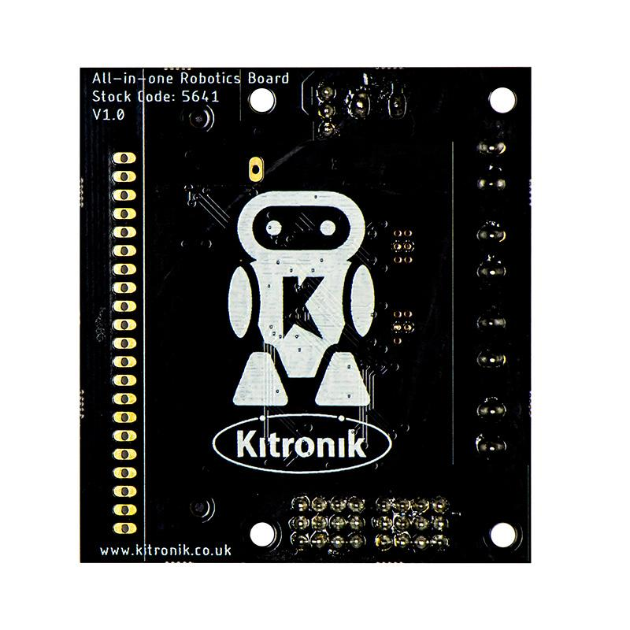

Slide 3
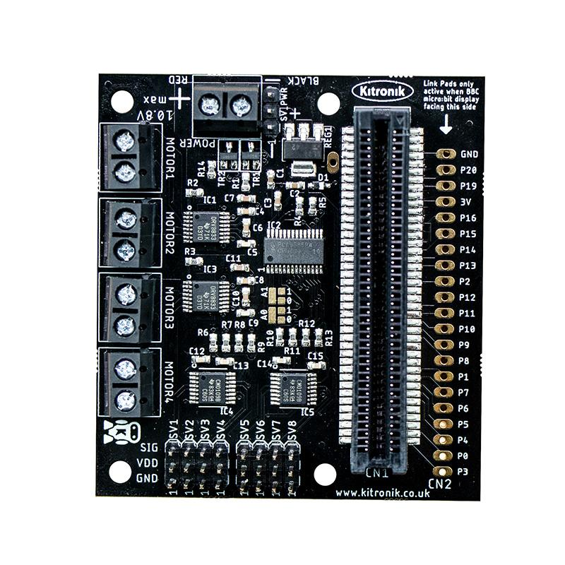
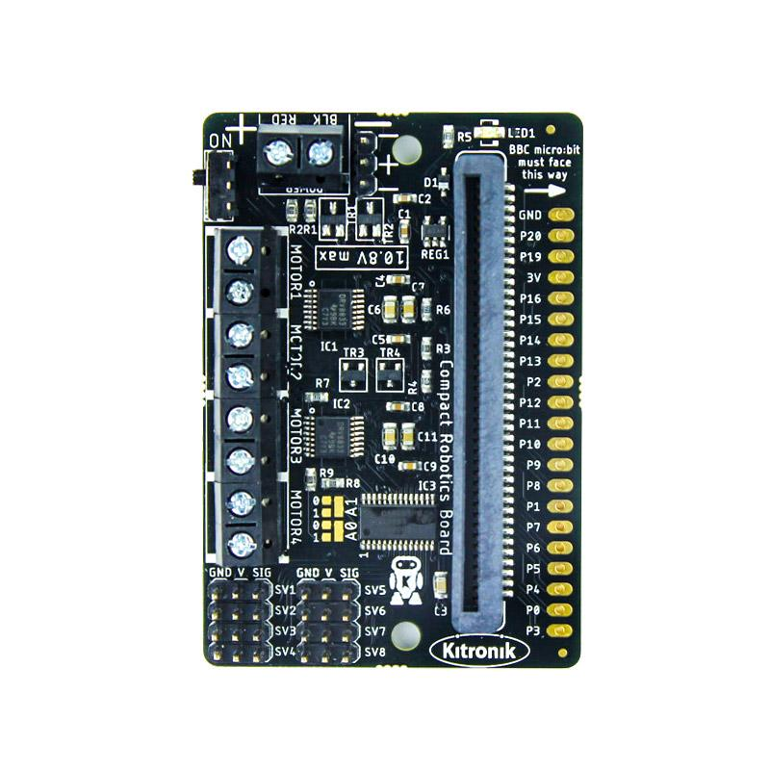

Slide 4





Slide 5
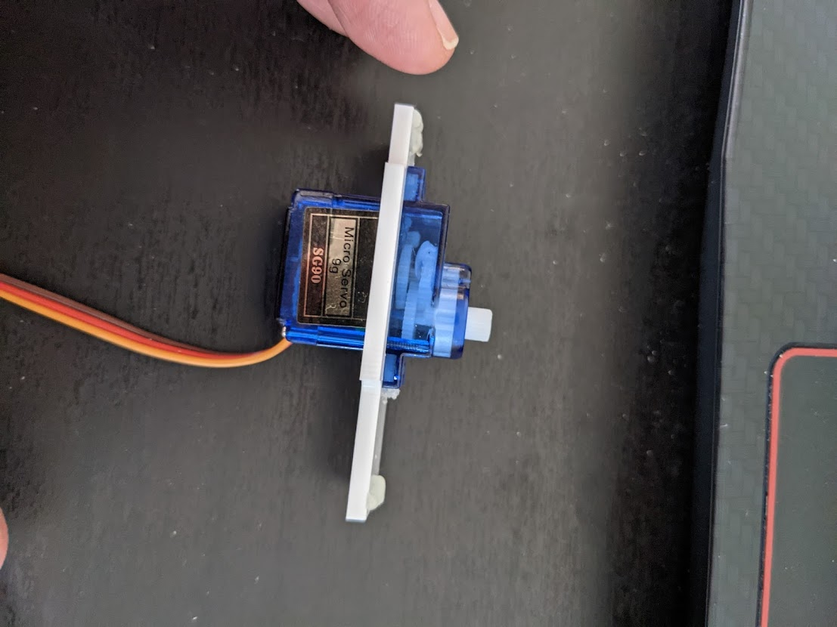
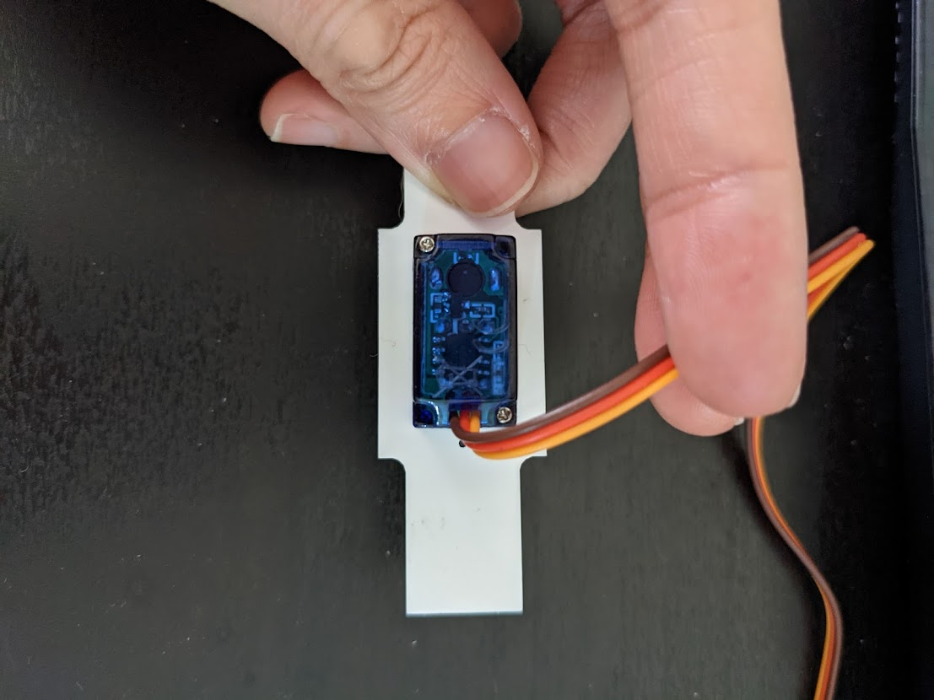
Motor Shaft
Controller board
Gearbox
Wires

Slide 6
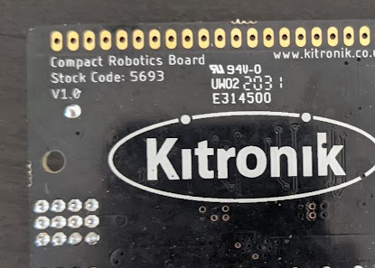
All-in-One Board
Compact Board

Slide 7
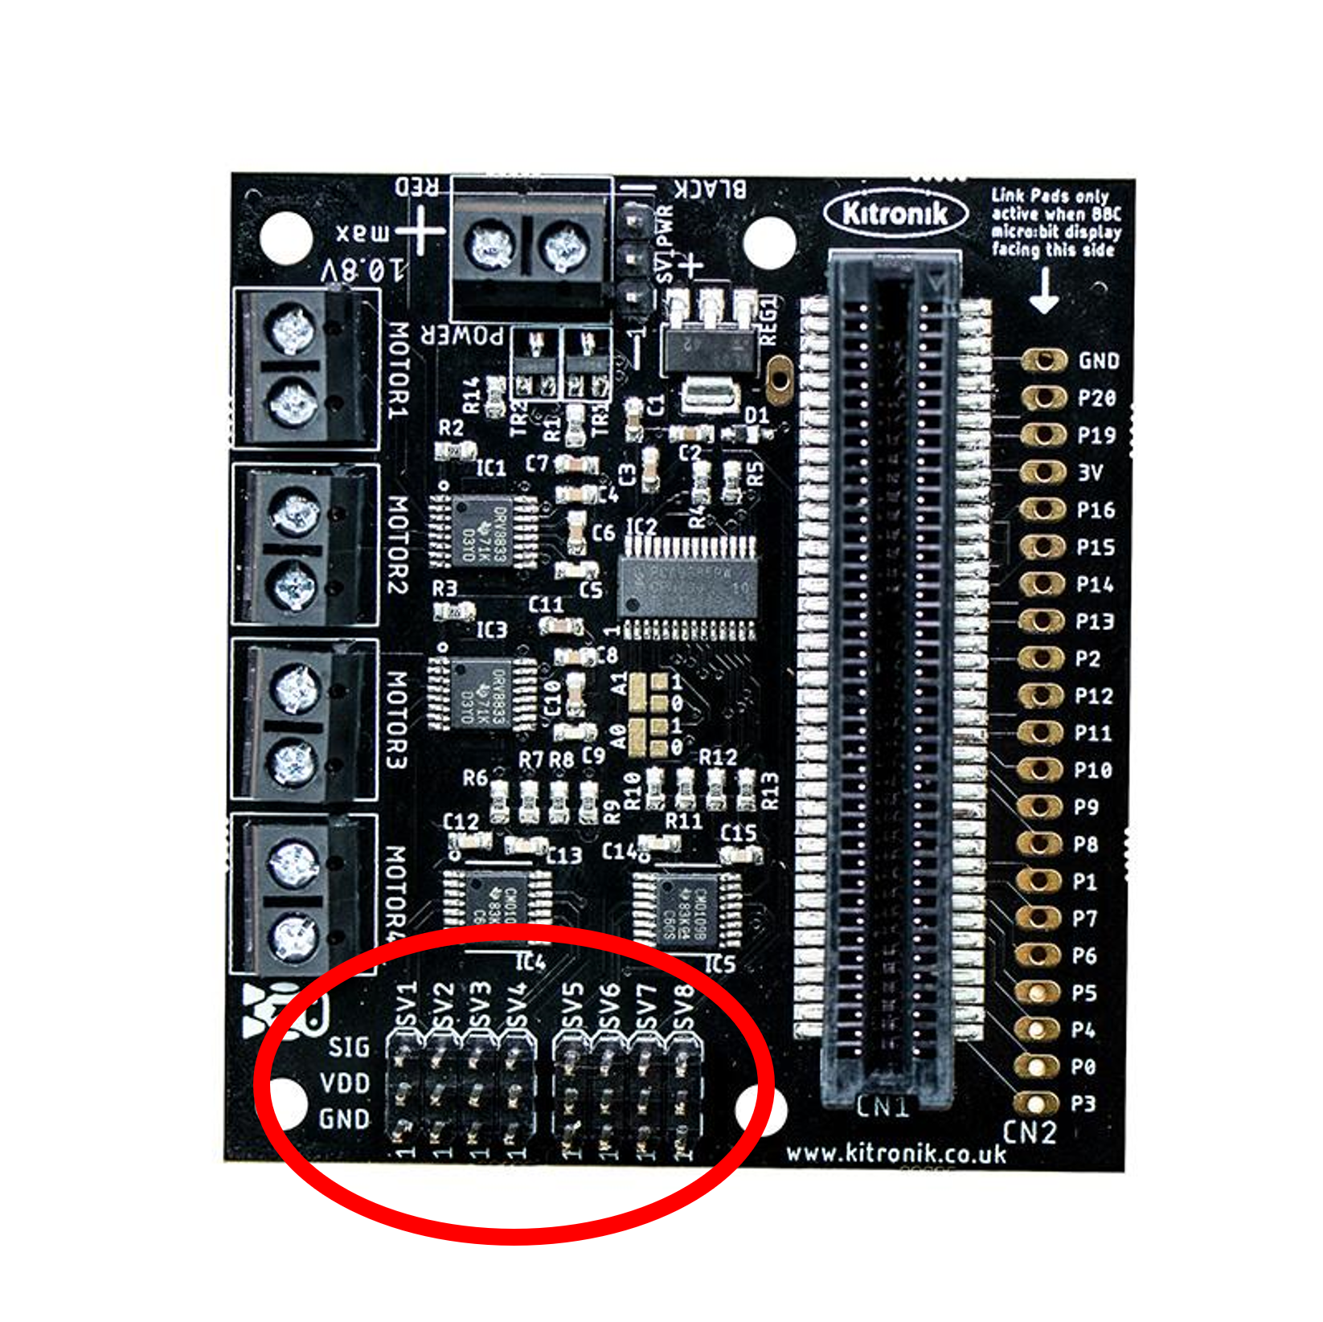
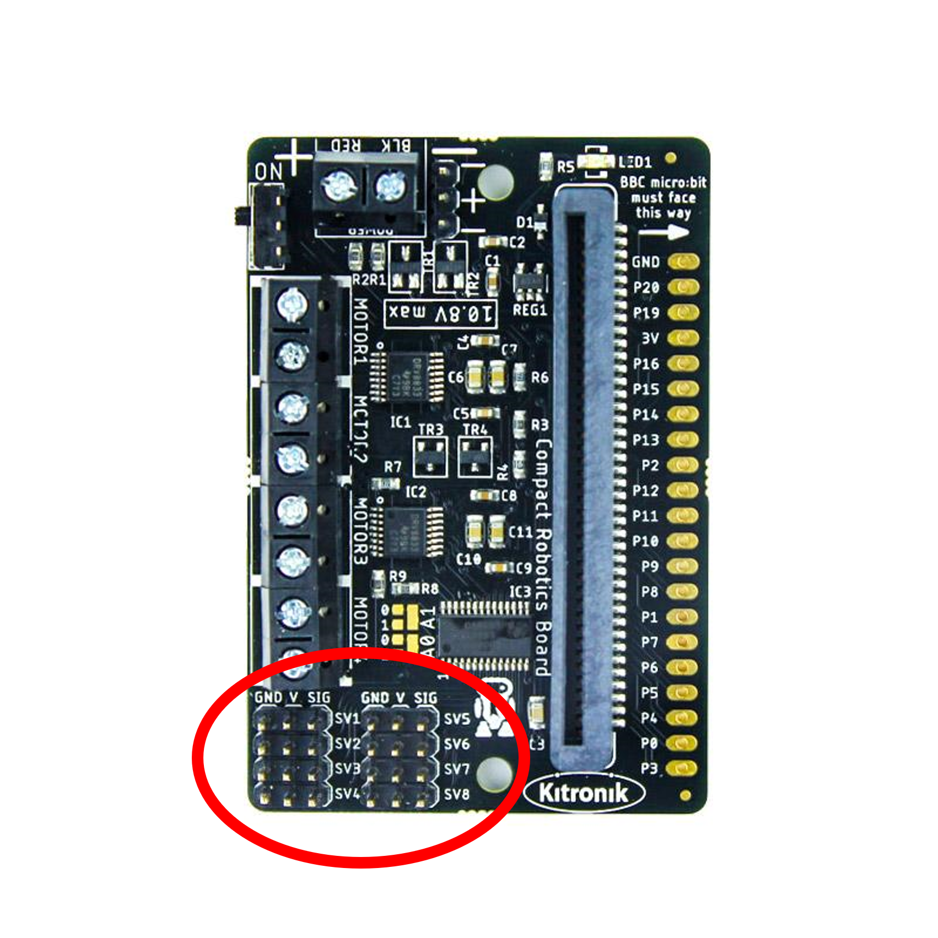
All-in-One Board
Compact Board

Slide 8
All-in-One Board
Compact Board

Slide 9
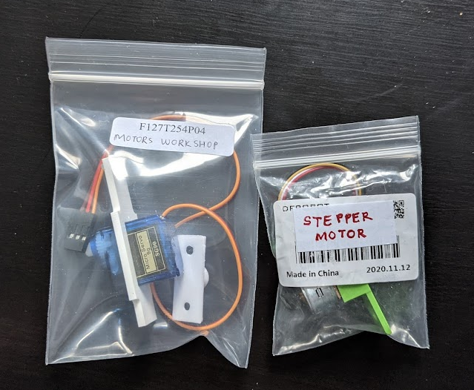

Slide 10
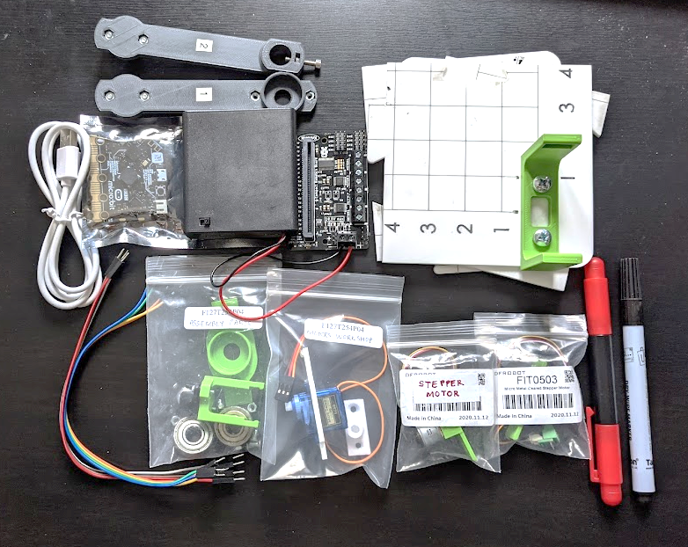
Robot Arms
AA 4x battery holder + Robotics Board
Base Board
Microbit
Screwdriver
USB Cable
Whiteboard marker
Jumper Cables
Motors Workshop bag
Stepper Motors
Assembly Parts bag

Slide 11
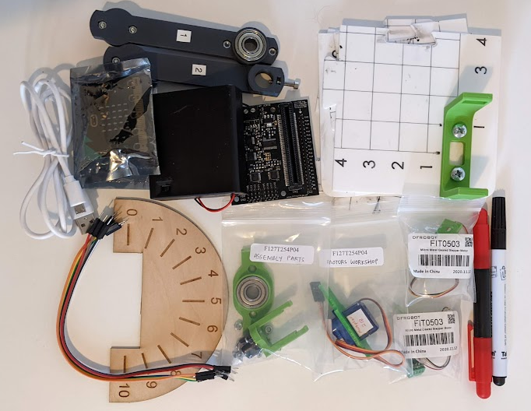
Robot Arms
AA 4x battery holder + Robotics Board
Base Board
Microbit
Screwdriver
USB Cable
Whiteboard marker
Jumper Cables
Stepper Motors
Dial
Assembly Parts bag
Motors Workshop bag

Slide 12
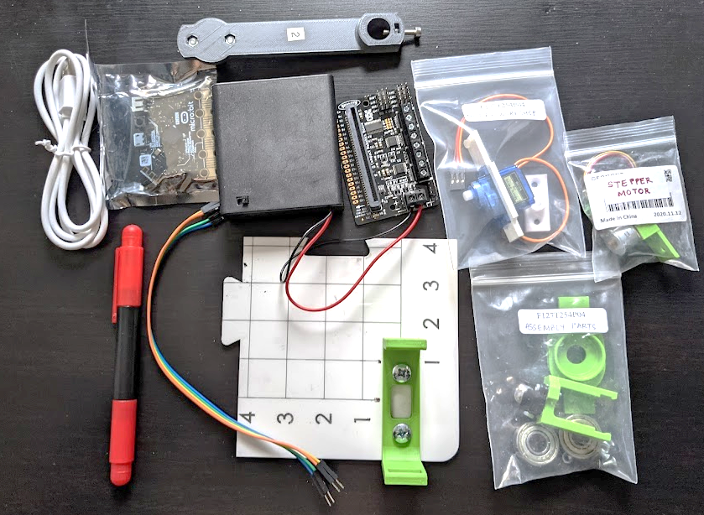
AA 4x battery holder + Robotics Board
Robot Arm 2
Microbit
Motors Workshop bag
USB Cable
Stepper Motor
Screwdriver
Assembly Parts bag
Jumper Cable
Base Board

Slide 13
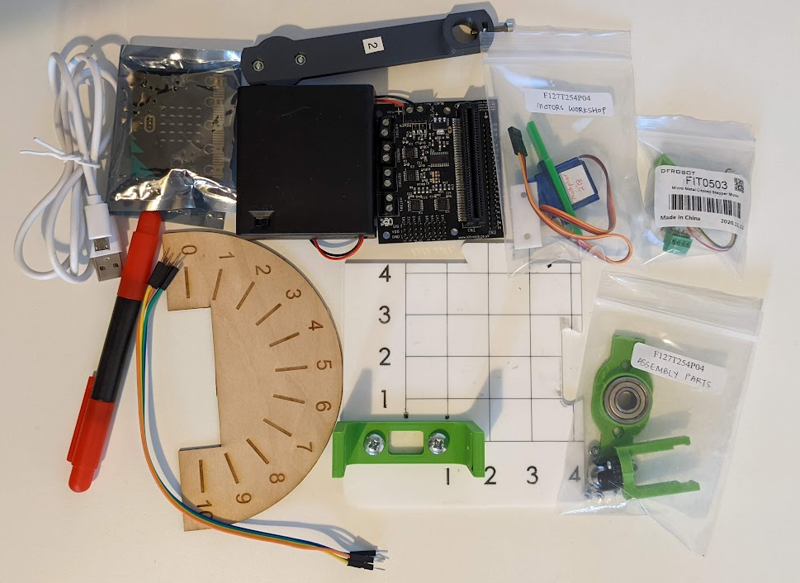
AA 4x battery holder + Robotics Board
Robot Arm 2
Microbit
Motors Workshop bag
USB Cable
Stepper Motor
Screwdriver
Assembly Parts bag
Dial
Jumper Cable
Base Board

Slide 14
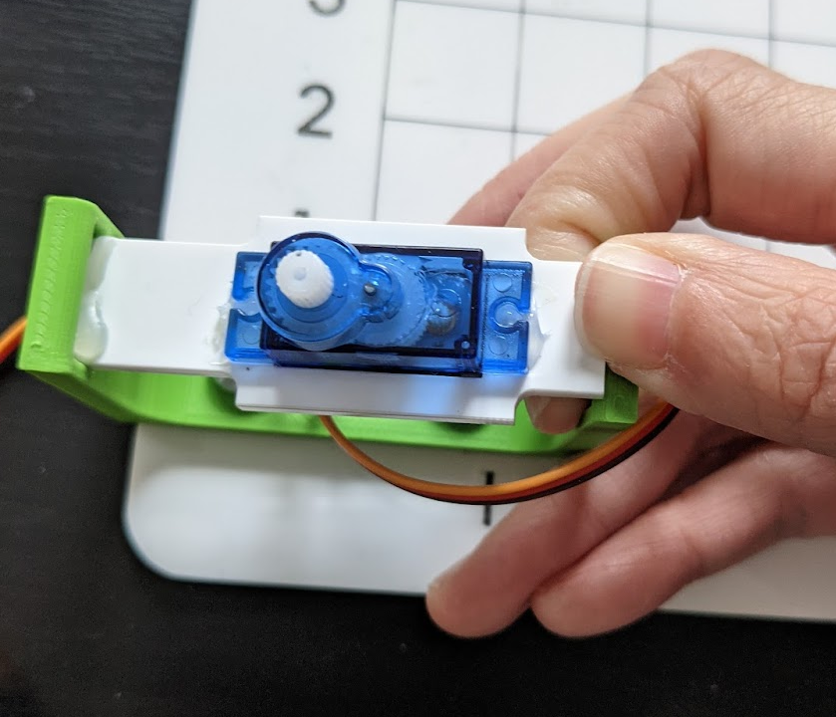
Gently push in
Slot in

Slide 15
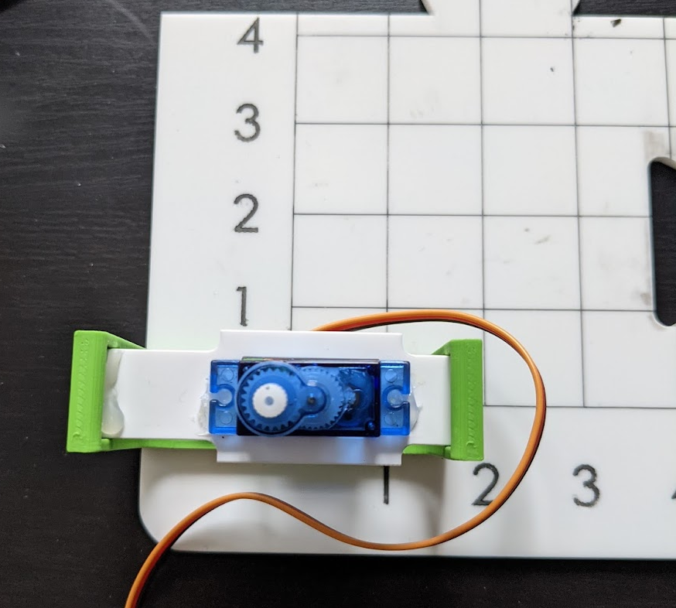

Slide 16
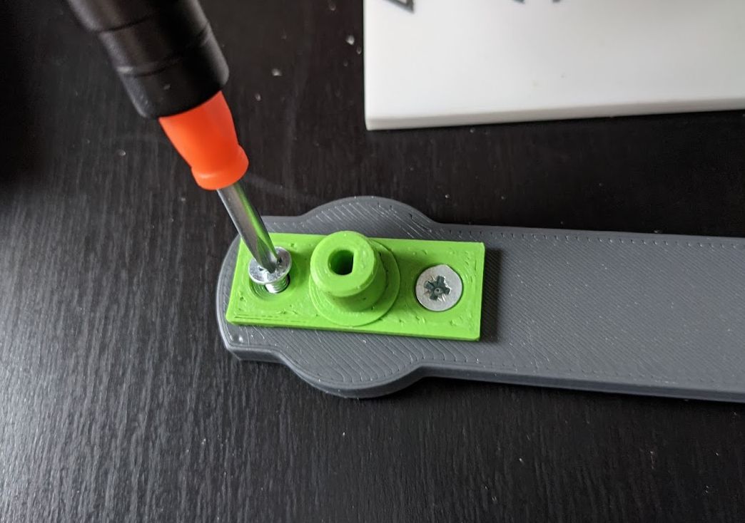

Slide 17
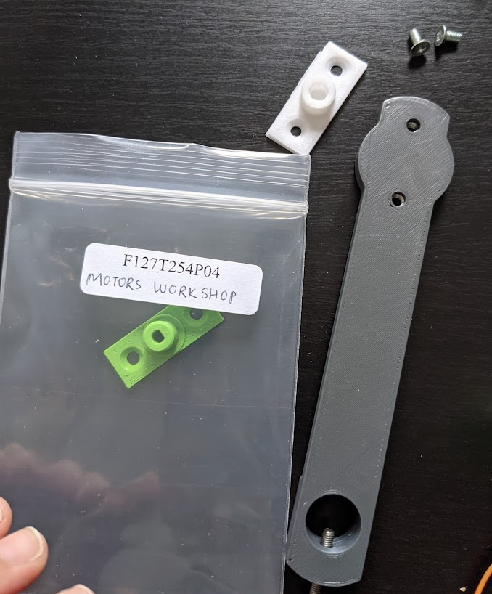
Round shape hole attachment attach to arm
D-shape hole attachment into bag

Slide 18
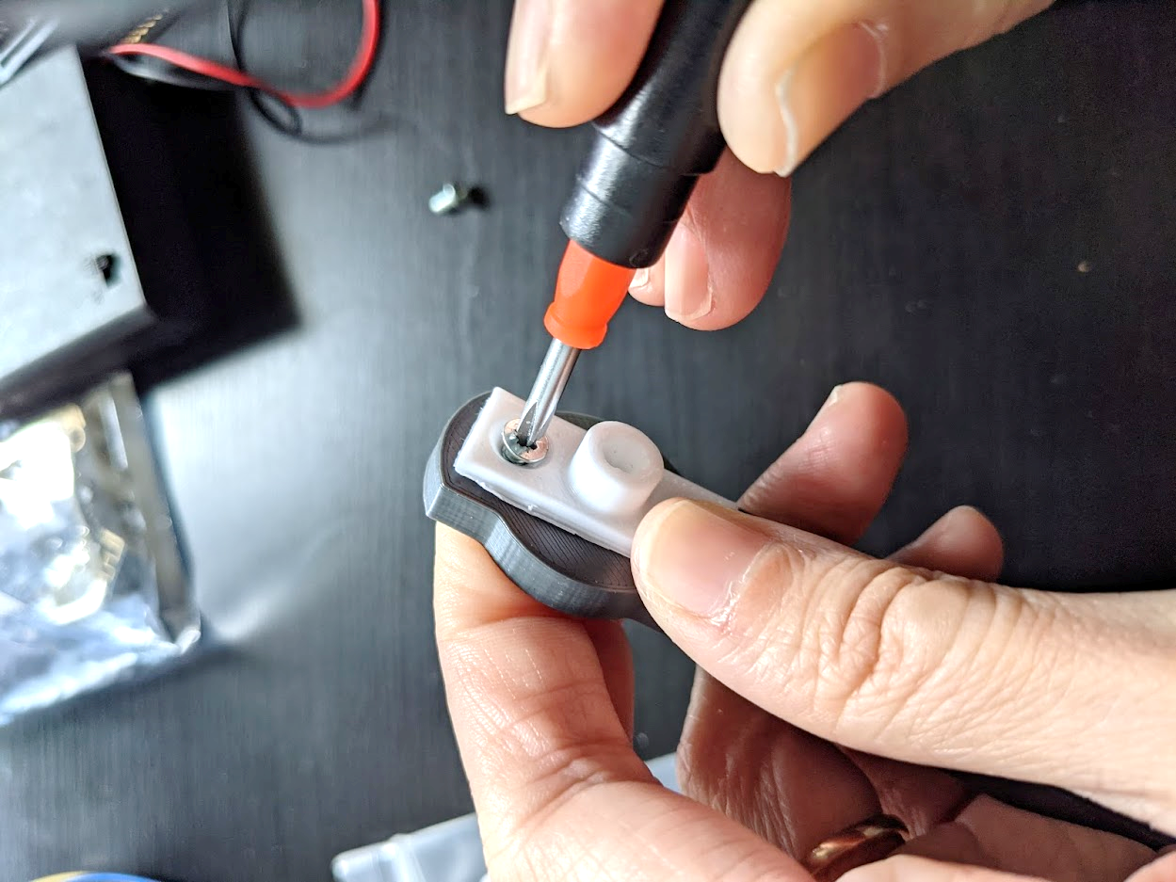
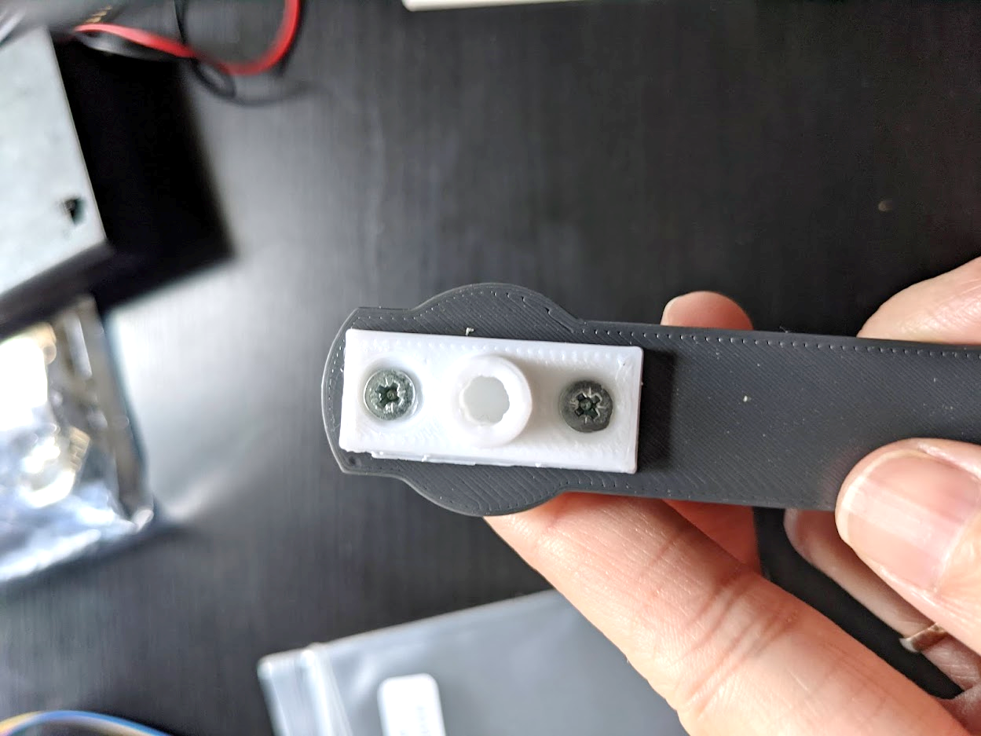
Put your finger to hold the nut in place

Slide 19
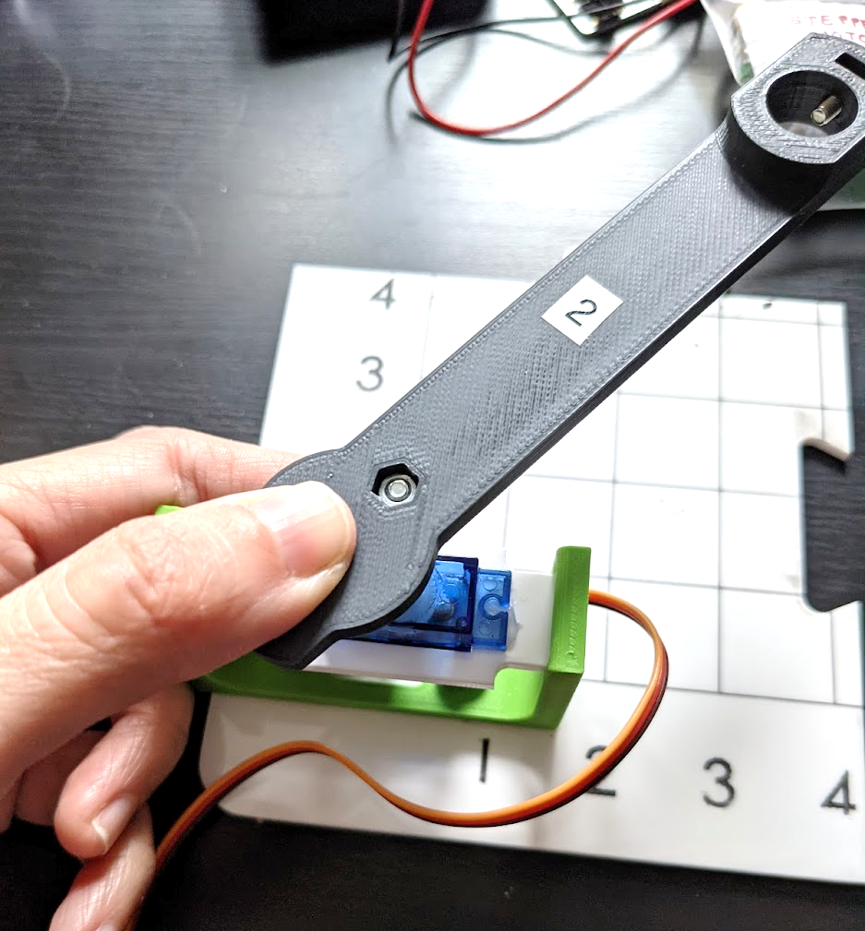

Slide 20
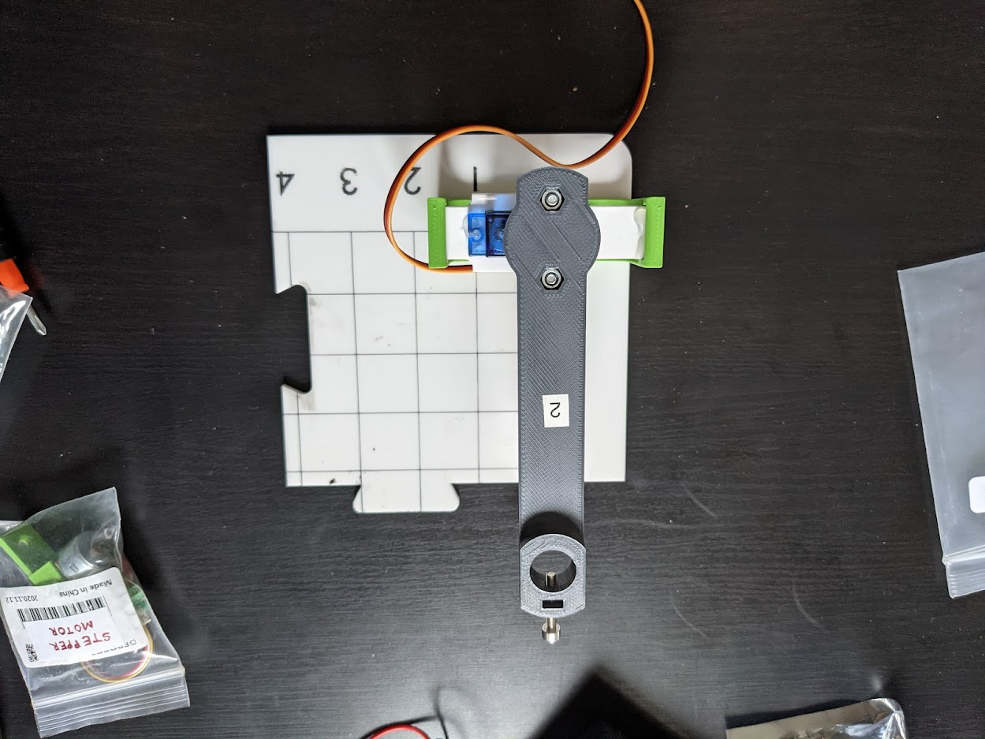

Slide 21
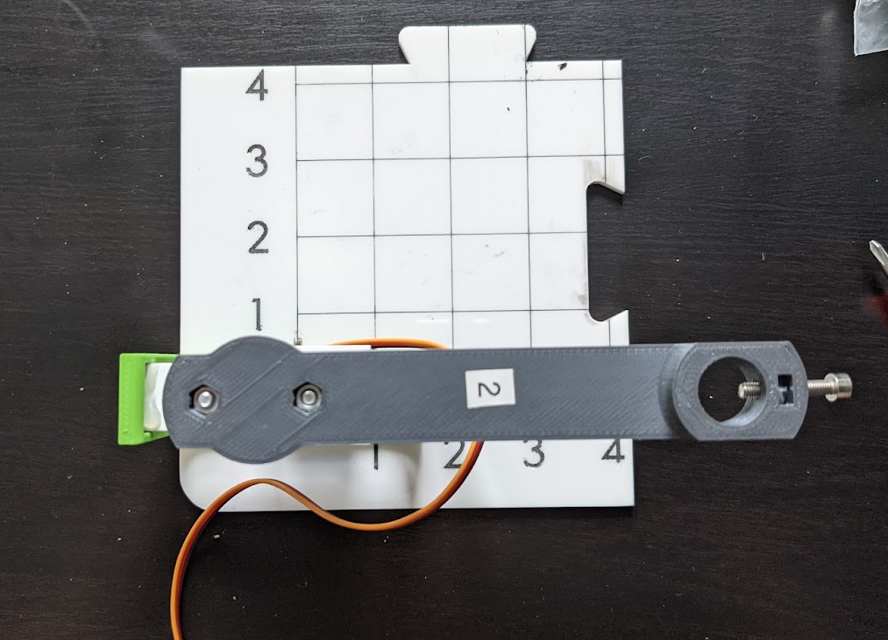

Slide 22
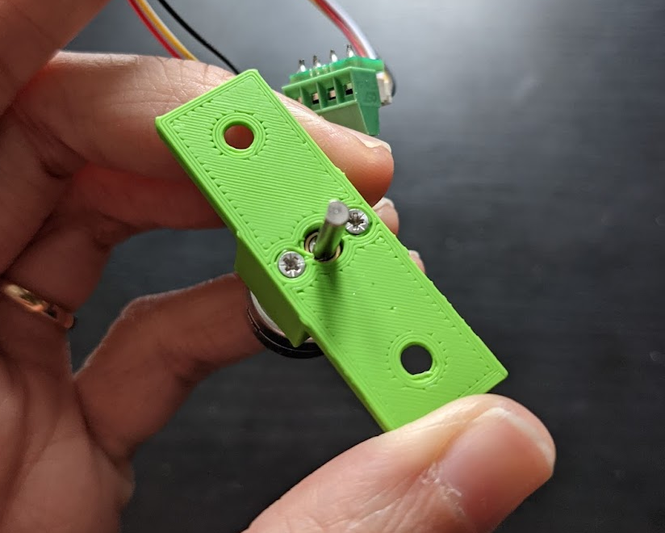

Slide 23
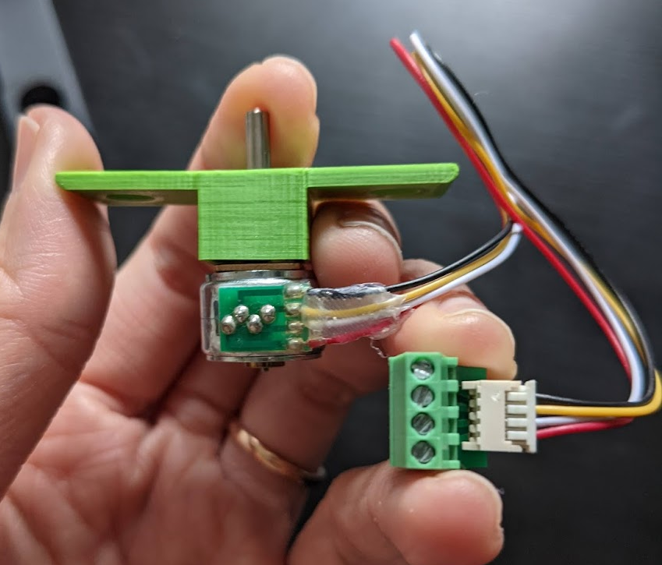
Motor Shaft
Gearbox (inside)
Wires
Motor Body
Motor Extension

Slide 24
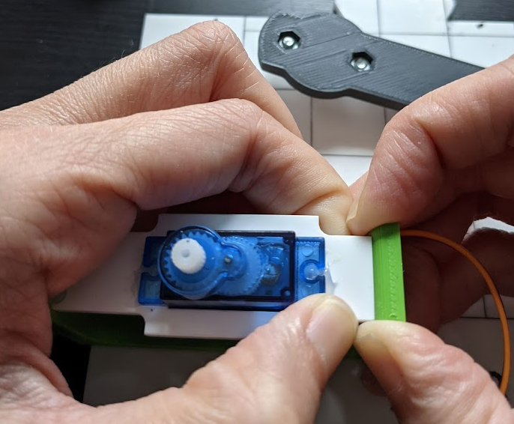
Gently pull it out

Slide 25
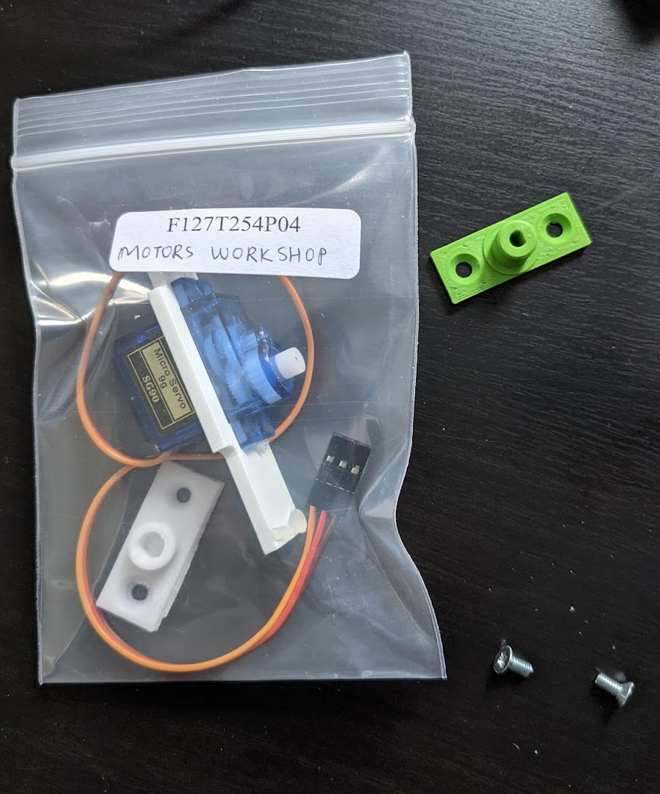
Take the D-shape hole attachment out
Put the servomotor and attachment back into the bag
Careful with the screws!

Slide 26
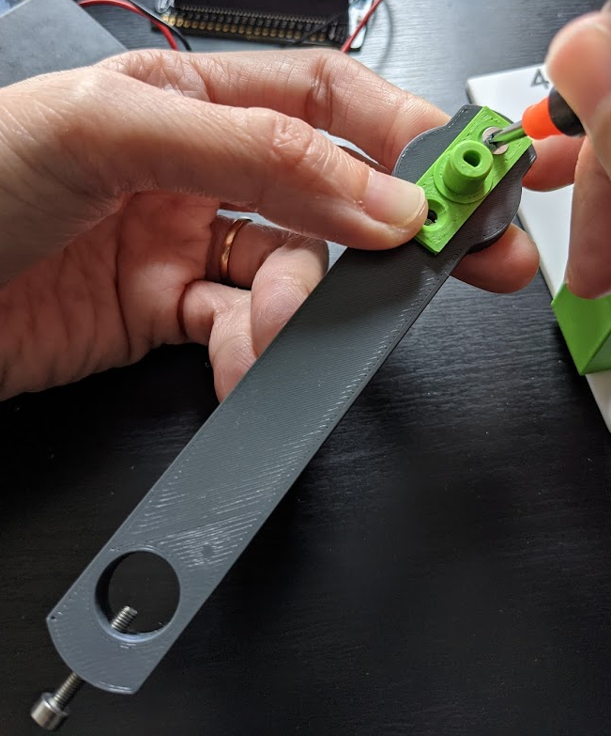
Flat side of D in this direction!

Slide 27
